Slide 1
Lecture 10: Regular Expression Properties and Conversion to NFA
Agenda
Properties of Regular Expression
Conversion RE to NFA
GNFA
RE-NFA-ε to DFA
Presented by
Prof. Vaibhav Narayan Chunekar
K. J. Somaiya College of Engineering, Vidyavihar, Mumbai

Slide 2
Properties of Regular Expression
Associativity Law: R1 ,R2 and R3 are three regular expression. Then
R1+(R2+R3)=(R1+R2)+R3
R1(R2.R3)= (R1.R2).R3
Distributive Law:
(R1+R2) R3=R1R3+R2R3
R1(R2+R3)=R1R2+R1R3
Commutative Law:
R1+R2=R2+R1
Note: ONLY UNION OPERATION IS COMMUTATIVE AND CONCATENATION IS NOT)
Identity Law:
R1+Φ=R1
R1 ε = R1
(R1*)*=R1*

Slide 3
Theorem : A language is regular if and only if some regular expression describes it.
Lemma 1: If a language is described by a regular expression then iot is regular.
Proof Idea: Assume that we have a regular expression R describing some language A. We show how to convert R into NFA recognizing it.
Proof: Lets convert R into an NFA N. We consider the six cases in the formal definition of regular expressions.

Slide 4
Equivalence with Finite Automata and RE
RE
NFA
DFA

Slide 5
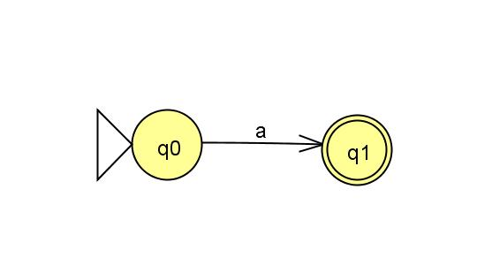
Case 1
If R= a for some a in Σ.
Then L(R)= { a} and the following NFA recognizes L(R).
This machine fits definition of NFA but not DFA because it has some states with no existing arrow for each possible input symbol .
Formally N=
{ {q0,q1},Σ,δ,q0, q1} where we describe δ
δ (q0,a)= {q1}, δ (r,b)= ∅
for r ≠ q0 or b ≠ a

Slide 6
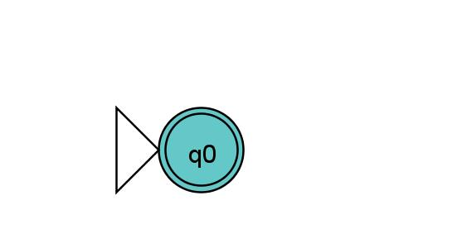
Case 2
If R= ε Then L(R)= {ε} and the following NFA recognizes L(R).
Formally N=
{ {q0},Σ,δ,q0, {q0}} where
δ (r,b)= ∅ for any r and b

Slide 7
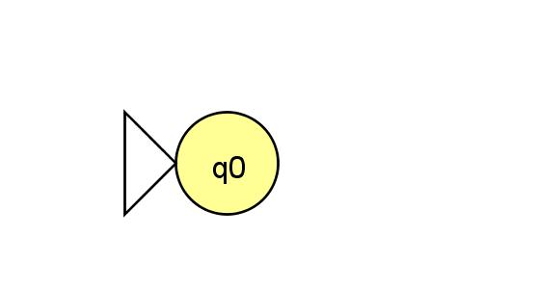
Case 3
If R= ∅ Then L(R)= ∅ and the following NFA recognizes L(R).
δ
Formally N=
{ {q0},Σ,δ,q0, ∅} where
δ (r,b)= ∅ for any r and b

Slide 8
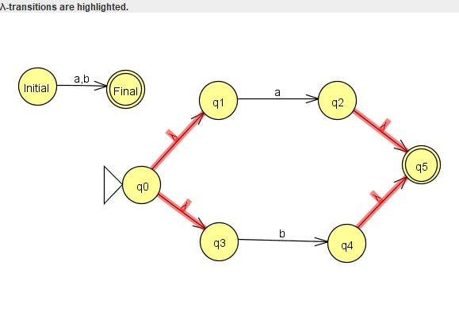
Case 4: R1U R2 or a+b

Slide 9
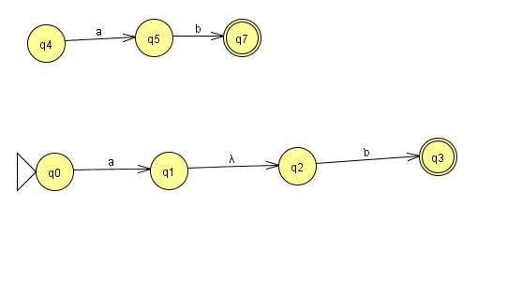
Case 5: R1.R2 OR a.b

Slide 10
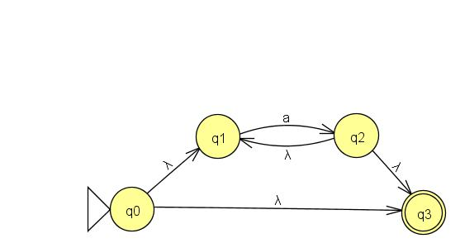
Case 6: R1* Or a*

Slide 11
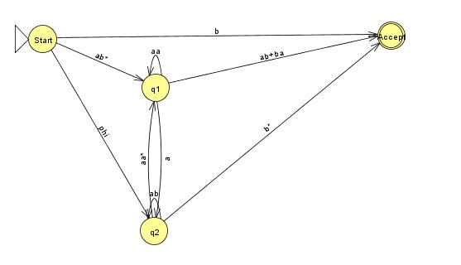
Generalized NFA:(GNFA):
It is a NFA that has a regular expression labelling its transition.
Example : GNFA

Slide 12
Generalized NFA:(GNFA):
Observations:
GNFA reads block of the symbols from the input.
GNFA moves along transition arrow connecting two states by reading block of the input symbols(String), which describe regular expression on that arrow.
GNFA is NFA. So different ways to process same input string.

Slide 13
GNFA Conditions
GNFA always has special form that meets the following conditions:
The start state has an transition arrow going to every other state but no arrows coming in from any other state.
There is only one accept state and accept state is not a start state.
Except from start and accept states, one arrow goes from every state to every other state and also from each state to itself.

Slide 14
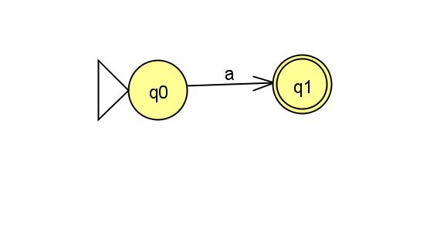

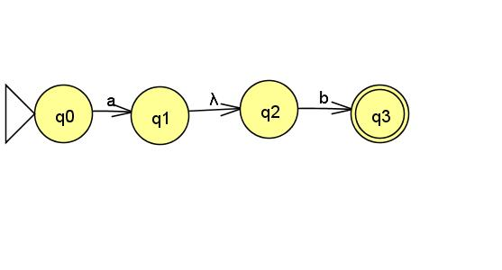
Example 1: Convert regular expression to NFA
(ab U a)* ➔
Step1: a ➔
Step2: b➔
Step3: ab➔

Slide 15
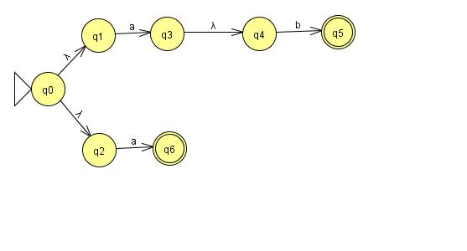
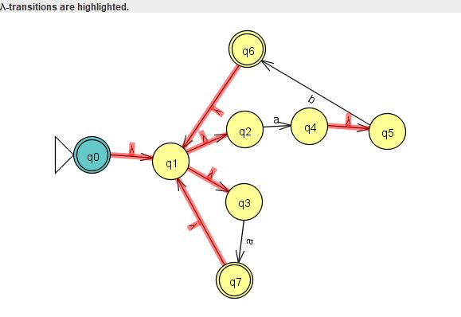
Example 1: Convert regular expression to NFA
(ab U a)* ➔
Step 4: ab U a ➔
Step5: (ab U a)* ➔

Slide 16
Example 2: (a+b)*aba
Step1: a
Step2: b
Step3: a+b
Step4: (a+b)*
Step5: aba
Step6: (a+b)*aba

Slide 17
Thanks !!!!
Any QUERY????

